Slide 1
Amazon Reviews Sentiment Analysis
Abdalrahman alshamaileh

Slide 2
Introduction
Problem Statement:
- Automated sentiment analysis of text data, specifically food quality reviews.
- Understanding client opinions at scale to improve customer experience.
Importance:
- Helps businesses enhance product quality and customer satisfaction.
- Saves time and effort compared to manual analysis.
Example:
- Analyzing reviews for thousands of products manually is time & effort consuming .
- Solution: Use NLP techniques to classify reviews as Positive, Negative, or Neutral.

Slide 3
Dataset Overview
Dataset Details:
- Total reviews: 500,000 (subset of 5000 used for demonstration).
- Source: Kaggle (link will be provided).
Data splitting on RoBERTa Model :
60% train,
20% validation,
20%test.

Slide 4
Deep Learning Approach
Models Used:
1. VADER:
- Lexicon-based approach.
- Scores sentiment using predefined rules.
2. RoBERTa:
- Transformer-based deep learning model
- Pretrained on large datasets for contextual understanding and trained specifically on this task .
Purpose: Classify reviews as Positive, Negative, or Neutral.

Slide 5
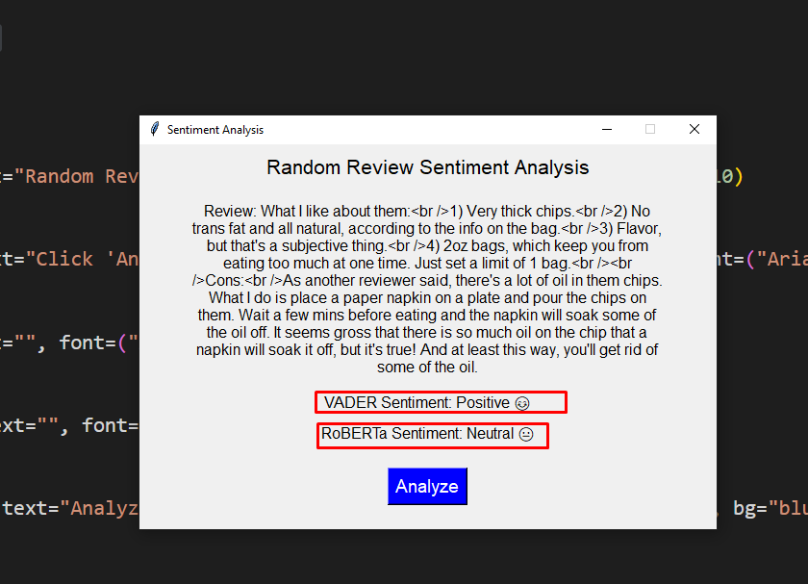
Applying the models on real reviews
1

Slide 6
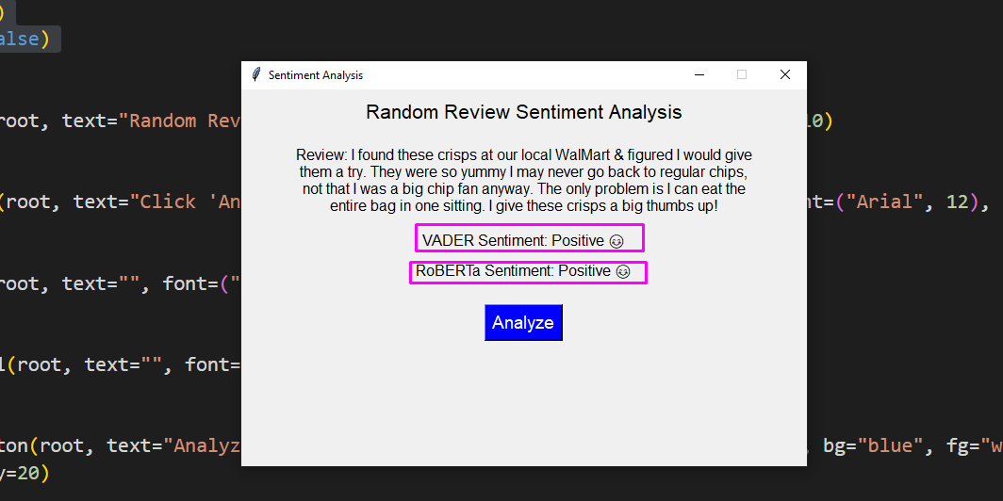
2

Slide 7
Hyper parameters applied
Learning rates
1e-05
0.001
Batch size
8
32
0.0001
64
Fixed size of epochs which is 5

Slide 8
 | Learning rate=1e-05 | Learning rate = 0.0001 | Learning rate=0.001 | loss
Batch size=8 | Accuracy= 0.8950 F1 score = 0.8695 Precision= 0.8176 | Accuracy= 0.7640 F1 score = 0.6618 Precision= 0.5837 | Accuracy= 0.7640 F1 score = 0.6618 Precision= 0.5837 | When lr=1e-05 Loss=0.3866 When lr=0.0001 Loss= 0.7205 When lr =0.001 Loss =0.7396
Batch size=32 | Accuracy= 0.8720 F1 score = 0.8700 Precision= 0.8683 | Accuracy= 0.7770 F1 score = 0.6795 Precision= 0.6037 | Accuracy= 0.7740 F1 score = 0.6518 Precision= 0.5837 | When lr=1e-05 Loss=0.0133 When lr=0.0001 Loss=0.7002 When lr =0.001 Loss =0.7023
Batch size= 64 | Accuracy= 0.8217 F1 score = 0.8200 Precision= 0.8100 | Accuracy= 0.7640 F1 score = 0.6618 Precision= 0.5837 | Accuracy= 0.7640 F1 score = 0.6618 Precision= 0.5837 | When lr=1e-05 Loss=0.0166 When lr=0.0001 Loss=0.7040 When lr =0.001 Loss = 0.6971
Epochs | 5 | 5 | 5

Slide 9
Model Best Performance Comparison:
| Metric | VADER | RoBERTa |
| Accuracy | 0.8070 | 0.8950 |
| Precision | 0.7641 | 0.8683 |
| F1-Score | 0.7767 | 0.8695 |
Key Insights:
- RoBERTa outperforms VADER in all metrics.
- VADER struggles with ambiguous or complex sentences.
The best accuracy and f1-score for Roberta model :
When lr=1e-05 and batch size =8 and epochs=5
And the best precesion When lr=1e-05 and batch size=32

Slide 10
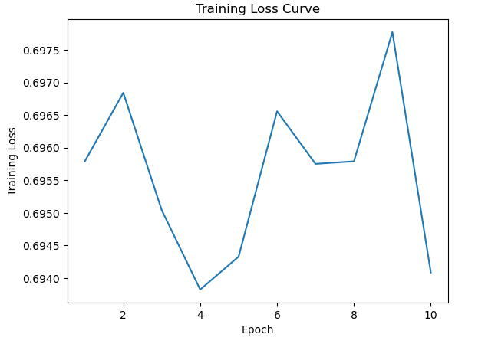
training loss over time on Roberta model
Notes:
It performed better but it takes longer time +30 minutes when the epochs is more than 10

Slide 11
Challenges and Future Work
Challenges:
- VADER
- Struggles with sarcasm, irony, or ambiguous text.
- Limited understanding of context or nuances in language.
-RoBERTa
- its computationally expensive, requires more resources compared to VADER.
-Data imbalancing
Future Work:
- Scale the project with a larger dataset.
- Develop a platform for integration with e-commerce businesses.
- Collaborate with data engineers for optimized data pipelines.

Slide 12
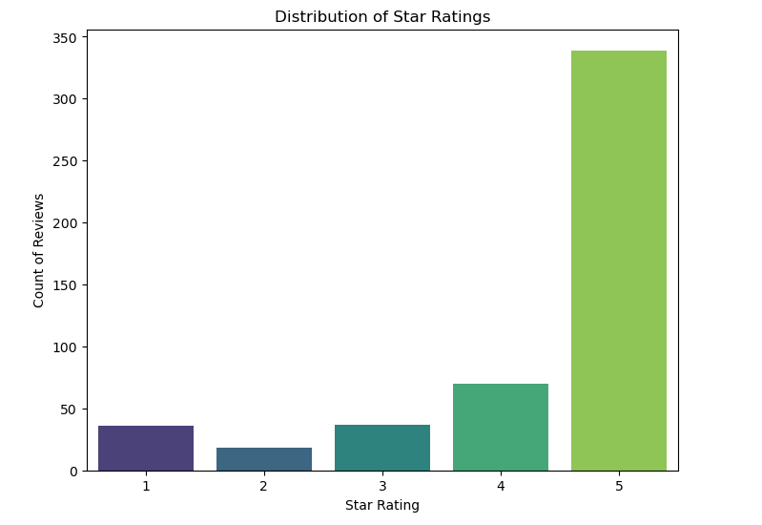
Notes:
When I was working on 500 sample the 5star rating which is positive was dominant …. So its kind of imbalanced so I increase the number of samples to 1000 then 2000 then 5000 until it was balanced.

Slide 13
Questions ?

Slide 14
References
Dataset: Kaggle (https://www.kaggle.com/datasets/snap/amazon-fine-food-reviews)
Models: VADER, RoBERTa
libraries Used: [ Transformers, nltk.sentiment, pandas,Numpy, NLTK , matplotlip…etc]

